Slide 1
Next word Prediction
Using NLP & Deep Learning
Prepared By:
Botcha Sandhya sri -RA2011026010280
Varsha S- RA2011026010286
Urvi Bhanu Hirani -RA2011026010293
Akkati Deeksha -RA2011026010301

Slide 2

Introduction
Natural Language Processing (NLP) and Deep Learning have enabled the development of powerful applications for next-word prediction. This technology has the potential to revolutionize the way people interact with computers and machines. The goal of this project is to explore the possibilities of using NLP and Deep Learning to create a next word prediction system that can accurately predict the next word in a sentence.

Slide 3

Problem Statement
The problem to be solved is to develop a system that can accurately predict the next word in a sentence given a set of input words. The system should be able to take into account the context of the sentence and the surrounding words to make an accurate prediction.

Slide 4
Objective
The objective of this project is to build a next word prediction model using Natural Language Processing (NLP) and Deep Learning techniques. The model will be trained on a large corpus of text data, and will learn to predict the most likely word to follow a given sequence of words.

Slide 5
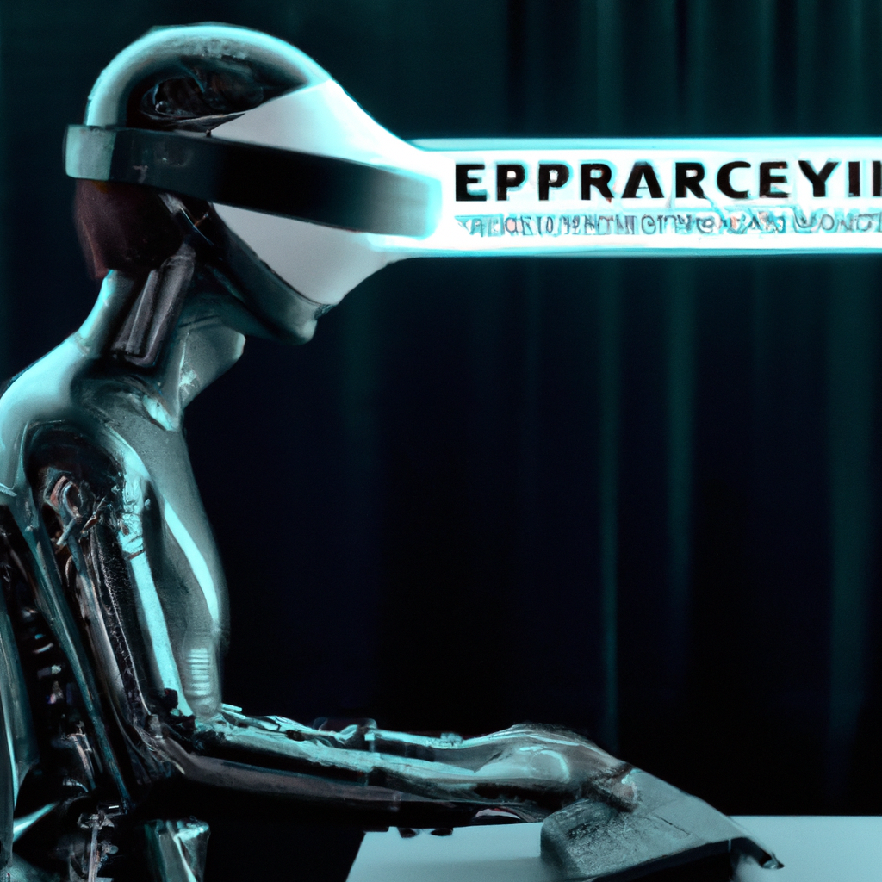
Motivation
Next word prediction has a wide range of potential applications, including: Improving the speed and accuracy of text entry on mobile devices and computers. Enhancing the user experience of chatbots and virtual assistants. Assisting writers and editors in the composition and editing of text documents. Improving the performance of machine translation systems by predicting the most likely next word in the target language.

Slide 6


Motivation (cont.)
Furthermore, NLP and deep learning are rapidly advancing fields with many exciting research opportunities. By working on this project, we can gain hands-on experience with cutting-edge techniques and contribute to the development of a useful and impactful application.

